Slide 1
WELCOME

Slide 2
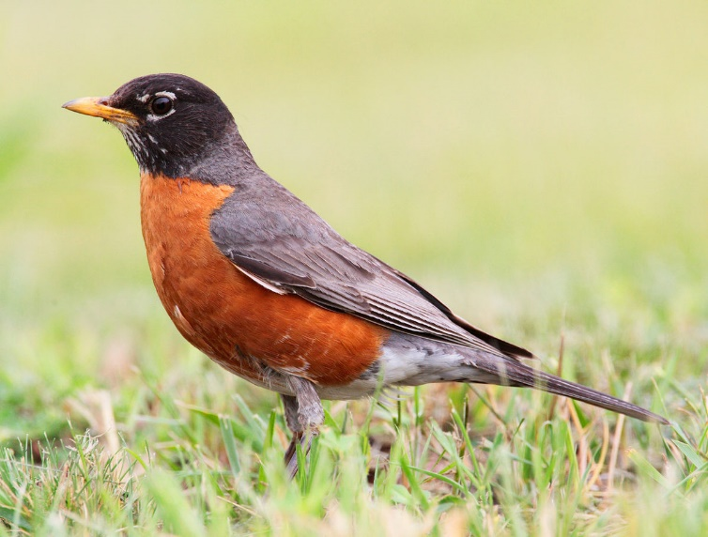
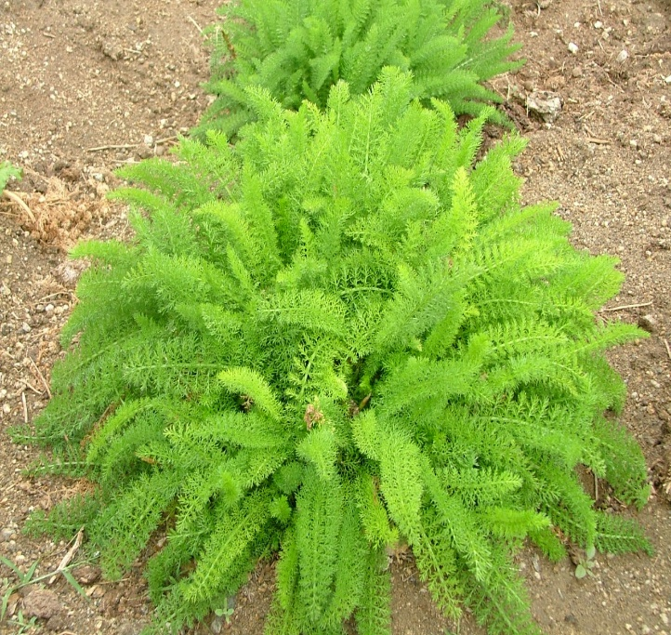

Living Organisms
An organism refers to a living thing that has an organized structure, can react to stimuli, reproduce, grow and adapt
Habitat
Terrestrial Habitat
Aquatic habitat

Slide 3
Some terrestrial habitat
1
Desert
2
Mountain
3
Grassland
BYE

